Slide 1

Presented by: Shivangi Gupta
Notes:
MediBuddy is a digital healthcare platform for an inpatient hospitalization, outpatient services, and corporate wellness benefits.
MediBuddy is the award-winning technology platform from Medi Assist that transforms the health insurance industry at the very core. MediBuddy, with its diverse offerings for various stakeholders of the health benefits industry, makes the process of discovering, accessing, utilizing, and monitoring health benefits seamless, real-time, and virtually
paperless.

Slide 2

Table of Contents
Overview
Purpose Statement (What are we talking about?)
Exploratory Data Analysis (EDA)
Key Business Questions & Insights
Conclusion
Appendix

Slide 3
Overview
Company Name: MediBuddy
Founded: 2000 Headquarters: Bangalore, Karnataka, India Industry: Digital Healthcare & Health Insurance
About MediBuddy: MediBuddy is a leading digital healthcare platform that offers inpatient hospitalization, outpatient services, and corporate wellness benefits. It is an award-winning technology platform by Medi Assist, revolutionizing the health insurance industry with seamless, real-time, and virtually paperless solutions.
Mission: Transforming healthcare accessibility with innovation & efficiency.
BMI: Body Mass Index
Notes:
MediBuddy is a digital healthcare platform for an inpatient hospitalization, outpatient services, and corporate wellness benefits.
MediBuddy is the award-winning technology platform from Medi Assist that transforms the health insurance industry at the very core. MediBuddy, with its diverse offerings for various stakeholders of the health benefits industry, makes the process of discovering, accessing, utilizing, and monitoring health benefits seamless, real-time, and virtually
paperless.
The company was founded in 2000 and based in Bangalore, Karnataka, India.

Slide 4
What are we talking about?

Slide 5
Purpose Statement
Identify if the key factors like gender, BMI, age, smoking status, geographic location, and number of dependents influences insurance claims and policy costs.
BMI: Body Mass Index
Notes:
MediBuddy is a digital healthcare platform for an inpatient hospitalization, outpatient services, and corporate wellness benefits.
MediBuddy is the award-winning technology platform from Medi Assist that transforms the health insurance industry at the very core. MediBuddy, with its diverse offerings for various stakeholders of the health benefits industry, makes the process of discovering, accessing, utilizing, and monitoring health benefits seamless, real-time, and virtually
paperless.
The company was founded in 2000 and based in Bangalore, Karnataka, India.

Slide 6
Exploratory Data Analysis (EDA)

Slide 7
Exploratory Data Analysis
There are two datasets we merged:
One having the age and BMI(Body Mass Index) that is received from a pre health checkup before the policy cover.
Other dataset includes some personal details such as the no. of children, whether the person smokes or not, the location where the person is from.
Summary Statistics
Gender Distribution: There are 676 males and 662 females.
Age Range: 18 to 64 years, with an average of ~39 years.
BMI Range: 15.96 to 53.13, with an average of ~30.66.
Insurance Charges: Highly Variable, ranging from ₹1,121.87 to ₹63,770.42 .
Children (Dependents): 0 to 5 dependents, with most people having 0 - 2.
Smokers vs. Non-Smokers: 1,064 are non-smokers, and 274 are smokers.
Region Distribution: Southeast has the highest count (364), followed by Southwest, Northwest, and Northeast.
BMI: Body Mass Index

Slide 8
Business Questions and
Insights

Slide 9
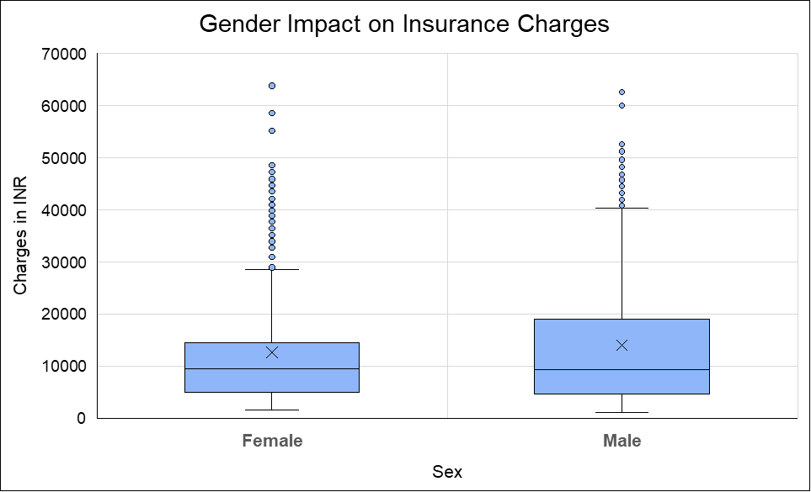
Does the gender of the person matter for the company as a constraint for extending policies?
Outliers
The Median Insurance charges of both genders appear to be similar, but distribution differs.
Highest Outliers are frequent among males than females.
Median
Gender does not appear to have a significant impact on insurance charges.
Notes:
Does gender matter for policy extension?
The boxplot shows that gender does not significantly affect the insurance claim amounts. Males and females have similar distributions, suggesting that gender should not be a constraint.

Slide 10
What is the average amount of money the company spent over each policy cover?
Average amount of money the company spent over each policy cover:
₹ 13,270.4223
Notes:
Average amount spent per policy cover:
The company spends an average of ₹13,270.42 per policy.

Slide 11
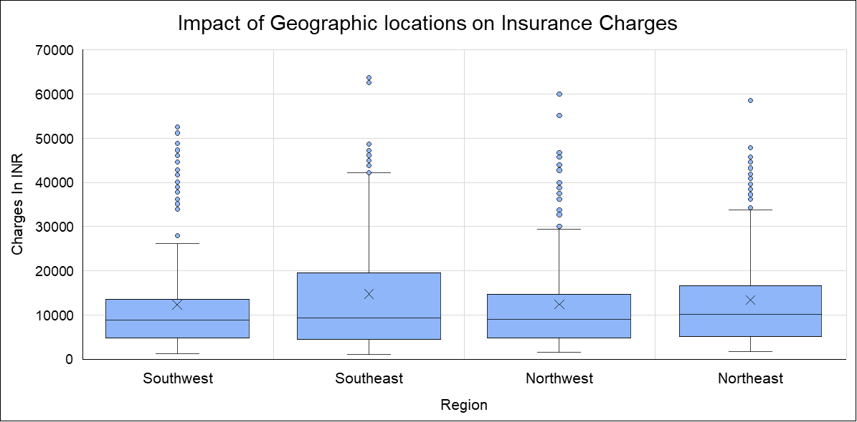
Should the company need to offer separate policies based upon the geographic location of the person?
The Median Insurance Charges appear to be similar across all four regions.
Each region has a significant number of high-value outliers, likely from high-risk individuals (e.g., smokers or those with high BMI).
Geographic location might not have a strong impact on insurance charges.
BMI: Body Mass Index
Notes:
Your box plot shows the distribution of insurance charges across different geographic regions (Southwest, Southeast, Northwest, and Northeast).
Insights from the Box Plot:
Median Charges: The median insurance charges appear to be similar across all four regions.
Interquartile Range (IQR): The spread of charges within the middle 50% of data is also comparable.
Outliers: Each region has a significant number of high-value outliers, likely from high-risk individuals (e.g., smokers or those with high BMI).
Overall Trend: Since the distributions look quite similar across regions, geographic location might not have a strong impact on insurance charges.

Slide 12
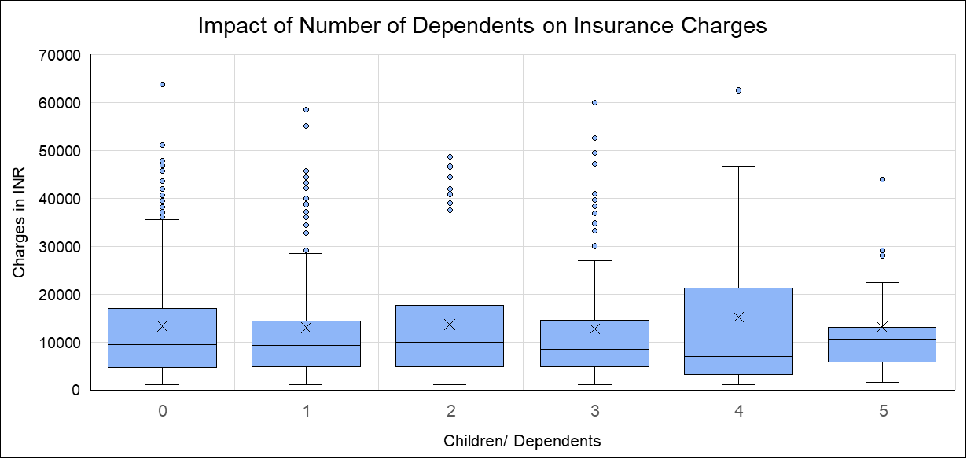
Does the no. of dependents make a difference in the amount claimed?
The Median Insurance charges remain fairly consistent across different number of dependents.
Multiple outliers at higher charge amounts across all groups. This suggests that some individuals have significantly higher insurance costs
Number of dependents/ children alone does not make a difference in the amount claimed.
Notes:
The boxplot reveals that the number of dependents/ children alone does not make a difference in the amount claimed as there is no clear increasing or decreasing trend in charges based on the number of dependents.
Conclusion
The number of dependents alone does not seem to have a strong impact on insurance charges.
Other factors like smoking status, BMI, age, and region may play a more significant role.
Further analysis (e.g., regression analysis) would be helpful to confirm if dependents have any statistical significance in predicting insurance costs.

Slide 13
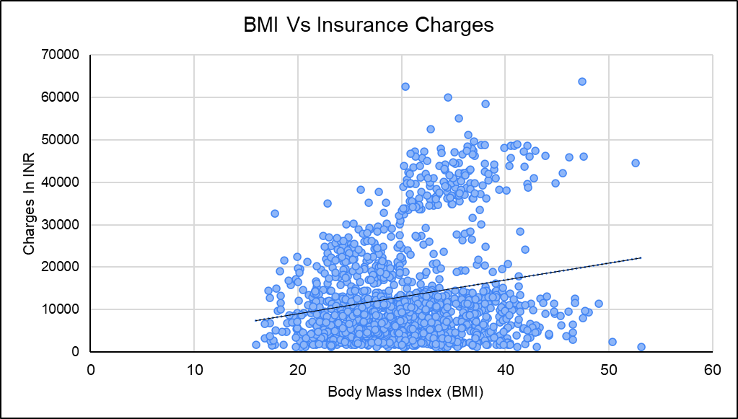
Does a study of persons BMI get the company any idea for the insurance claim that it would extend?
A positive trend is observed, indicating that higher BMI is generally associated with higher insurance costs.
Positive Trendline
BMI: Body Mass Index

Slide 14
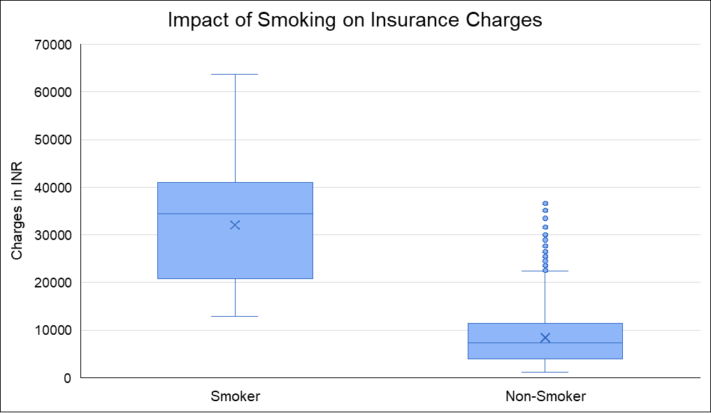
Is it needed for the company to understand whether the person covered is a smoker or a non-smoker?
Smokers have considerably higher median charges compared to non-smokers.
Non-smokers generally have lower insurance charges, but a few outliers indicate that some non-smokers still incur high charges.
Smoking dramatically increases insurance charges. This suggests that smoking is a major risk factor influencing insurance premiums.
BMI: Body Mass Index

Slide 15
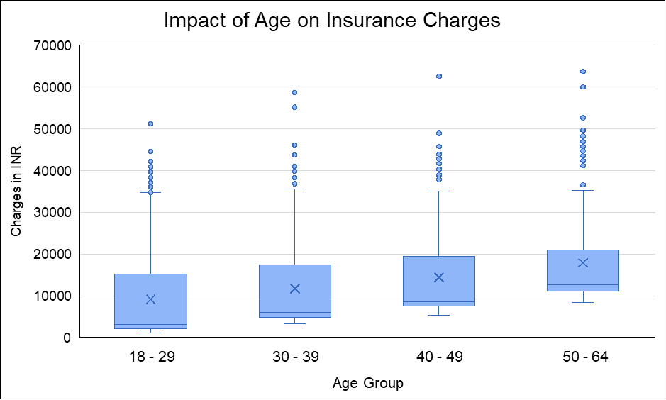
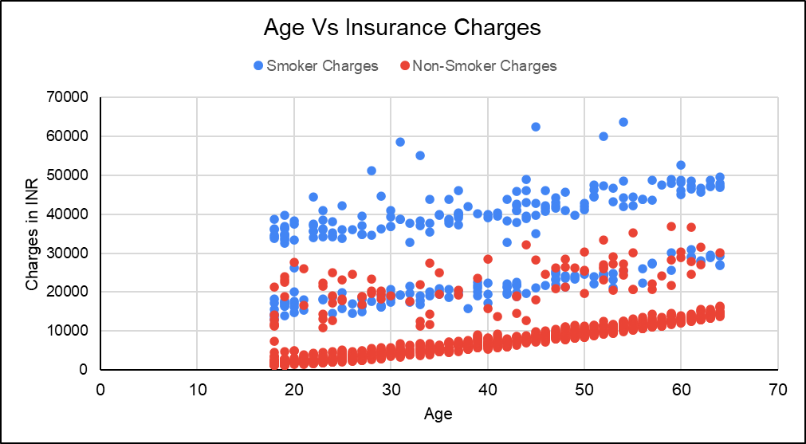
Does age have any barrier on the insurance claimed?
Older individuals, especially those over 40, tend to have higher insurance claims, making age a key factor in policy pricing.
Additionally, older smokers face even higher charges due to increased health risks.
Notes:
With increasing age we can see there are high outliers
Older individuals, especially smokers, tend to have higher claims. This suggests that age should be factored into policy decisions

Slide 16
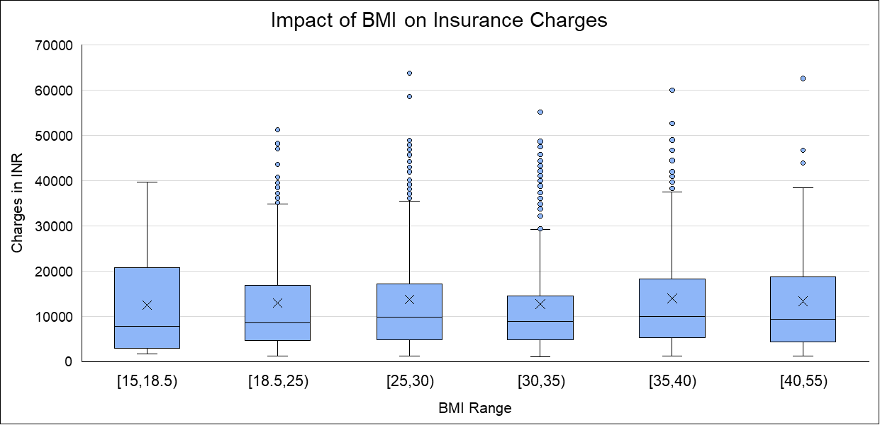
Can the company extend certain discounts after checking the health status (BMI) in this case?
Higher BMI is associated with increased insurance charges.
Insurance charges tend to rise with increasing BMI, reflecting higher associated health risks.
Individuals with lower BMI (below 25) tend to have lower claims. Offering discounts for healthier individuals could be a viable strategy.
BMI: Body Mass Index
Notes:
The normal range for a healthy BMI is considered to be 18.5 to 25. This range is applicable for adults 20 years old or older. The boxplot reveals that company can extend certain discounts to individuals with BMI lower than 25 as they tend to have lower claims. Offering discounts to healthier people will be a good approach.
Should discounts be extended based on BMI?
Individuals with lower BMI (below 25) tend to have lower claims. Offering discounts for healthier individuals could be a viable strategy.

Slide 17
Conclusions

Slide 18
Conclusions
1
3
Higher BMI values (above 30) tend to have higher insurance charges. This suggests that BMI can be used as a risk factor for policy pricing.
Older smokers, especially those over 40, tend to have higher insurance claims, making age a key factor in policy pricing.
2
4
Smokers have significantly higher insurance claims compared to non-smokers. The company should definitely consider this when setting policy prices.
Individuals with lower BMI (below 25) tend to have lower claims. Offering discounts for healthier individuals could be a viable strategy.

Slide 19
Appendix
Excel Project Link: MediBuddy Insurance Project
BMI: Body Mass Index
Notes:
MediBuddy is a digital healthcare platform for an inpatient hospitalization, outpatient services, and corporate wellness benefits.
MediBuddy is the award-winning technology platform from Medi Assist that transforms the health insurance industry at the very core. MediBuddy, with its diverse offerings for various stakeholders of the health benefits industry, makes the process of discovering, accessing, utilizing, and monitoring health benefits seamless, real-time, and virtually
paperless.
The company was founded in 2000 and based in Bangalore, Karnataka, India.

Slide 20
Thank You

